Slide 1

Public Informatics NLP Study: Are Emotions Conveyed Across Machines? Exploring Multilingual Sentiment Analysis
34:816:511:90 - Fall 2022
Akshita Velpuru, Lalithanjali Kesava Pillai, Dayvonn Jones

Slide 2
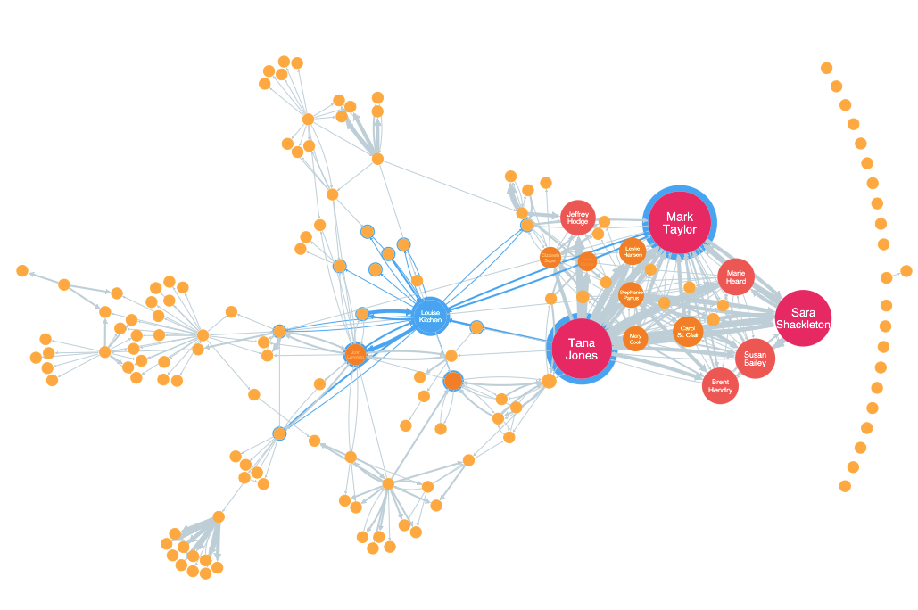
OVERVIEW
Natural Language Processing
Multilingual Sentiment Analysis
Methodology
Findings
Results

Slide 3
NATURAL LANGUAGE PROCESSING (NLP)
Unstructured human generated data fed into computers to generate a structured information using Artificial Intelligence.
Textual analytics is done by comparing the unstructured data with a predefined or pre-trained dictionary and derive insights.
NLP uses artificial intelligence and computational linguistics to understand large sets of data generated by humans everyday.

Slide 4
PROCESS OF TEXT MINING
Corpus Generation
Data Preparation
Data Analysis
Data Visualization
Identify the objective of the study.
Identification of the appropriate data sources.
Use of existing data, and web crawling of social media data.
Tokenization of words.
Lemmatization based on the language.
Removal of stopwords.
Parts-of-speech tagging.
General classification of the data.
Identification of sentiments, themes, and patterns.
Frequency analysis.
Topic cluster analysis.
Distribution of the data.
Quantitative metrics.
Confusion matrix.
Word clouds for frequency.

Slide 5
MULTILINGUAL SENTIMENT ANALYSIS
Sentiment analysis is a widely studied NLP task where the goal is to determine opinions, emotions, and evaluations of users towards an event, a service and or a product.
The sentiment analysis provides an automated method of analyzing sentiment with written languages making it easier to extract useful information from social networking platforms.
Sentiment analysis is language dependent including and not limited to word embeddings, sentiment lexicons, and annotated data.
It is challenging to collect data for different languages.

Slide 6
PREVIOUS RESEARCH STUDIES
Decision-making on a case study was analyzed using group chat transcripts through dominance as a factor.
Textual analytics establishes the relation between the language and the psychological process.
Establishing Service Quality Attributes based on user perceptions on a public transit system using Weibo microblogs in China.

Slide 7
GOALS OF OUR PROJECT
Analyze sentiments towards a public transit system, Renfe Spain using NLP.
Use of social media data in Spanish language to establish sentiments.
Use and compare two translation techniques, Google translation and Marian MT for accuracy after translation.
Use Lexicon-based and Machine learning sentiment analyzers to check the sentiments.
Identify themes and patterns from the human generated social media data.

Slide 8
METHODOLOGY
Data Collection
Collecting user opinions of Renfe Transit System through Twitter and Trip Advisor.
Data Cleaning and Processing
Translate Spanish tweets to English using Google Translate and Opus-mt tools to generate Gold Standard Corpus for the analysis.
Data Transformation
GSC was created with manually labelled polarity information. The sentences were categorized as Positive, Neutral and Negative sentiments.
Choice of Data Mining task and Algorithm
Four sentiment analysis approaches were selected: NLTK, Textblob, and Pattern for text classification at sentence level.
Evaluation and Interpretation
Measure the performance of the machine learning classifications employed in the study.

Slide 9
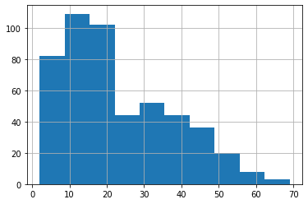
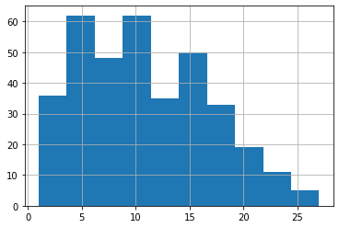
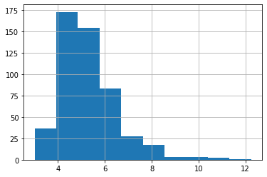
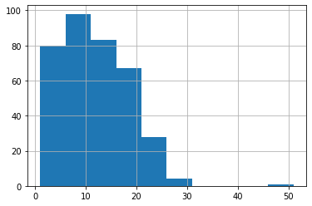
DATASET
DISTRIBUTION OF WORD COUNT IN SPANISH (SAMPLE)
DISTRIBUTION OF WORD COUNT IN ENGLISH - GOOGLE (SAMPLE)
DISTRIBUTION OF AVERAGE WORD COUNT IN SPANISH (SAMPLE)
DISTRIBUTION OF WORD COUNT IN ENGLISH - OPUS MT (SAMPLE)

Slide 10
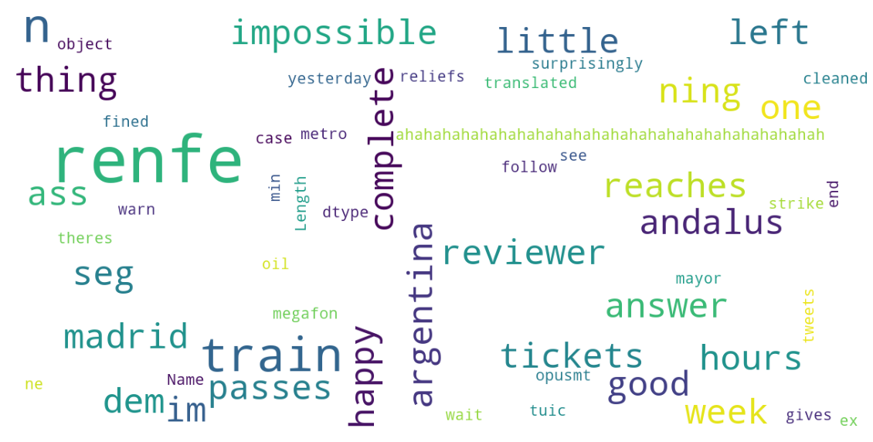
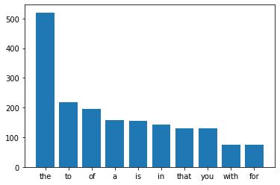
DATASET
FREQUENCY DISTRIBUTION OF STOP WORDS IN ENGLISH
WORD CLOUD OF TOP FREQUENTLY OCCURING WORDS IN ENGLISH

Slide 11
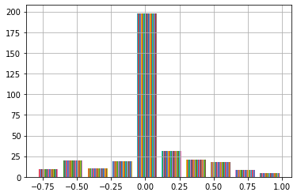
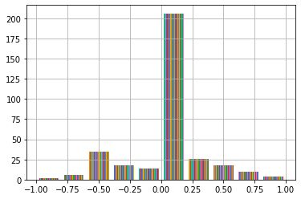
FINDINGS
DISTRIBUTION OF TEXTBLOB POLARITY SCORES - GOOGLE TRANSLATIONS
DISTRIBUTION OF TEXTBLOB POLARITY SCORES - OPUS TRANSLATIONS

Slide 12
FINDINGS
Gold Standard Vs Google-Textblob
Gold Standard Vs OpusMT-Textblob
Expected
Expected
+ve
Neu
-ve
+ve
Neu
-ve
-ve
11
15
6
-ve
9
17
6
Predicted
1
86
1
Predicted
1
85
2
Neu
Neu
+ve
52
85
82
+ve
65
76
78
Accuracy rate = 52.8%
Accuracy rate = 50.7%

Slide 13
FINDINGS
Gold Standard Vs Google-NLTK
Gold Standard Vs OpusMT-NLTK
Expected
Expected
+ve
Neu
-ve
+ve
Neu
-ve
-ve
18
8
6
-ve
20
5
7
Predicted
4
66
18
Predicted
9
59
20
Neu
Neu
+ve
53
82
84
+ve
51
79
89
Accuracy rate = 49.55%
Accuracy rate = 49.55%

Slide 14
FINDINGS
Gold Standard Vs Google-Pattern
Gold Standard Vs OpusMT-Pattern
Expected
Expected
+ve
Neu
-ve
+ve
Neu
-ve
-ve
11
15
6
-ve
9
17
6
Predicted
1
86
1
Predicted
1
85
2
Neu
Neu
+ve
52
85
82
+ve
65
76
78
Accuracy rate = 52.8%
Accuracy rate = 50.7%

Slide 15
OBSERVATIONS
Spanish Word | True English Word (in the context of the sentence) | Machine translated English word
Mal vamos | Bad path | Go/Going
para cu ndo | Until when | -
nefasta | disastrous | nefarious
ya est n | ready | already
ave | avenue | bird
lanzarnos al vac | platform | train
lamentable | unfortunate | pitiful
pillas | caught | pillas
pa mi | To me | Pa mi

Slide 16
RESULTS
TextBlob and Pattern sentiment analyzer have the same scores.
Accuracy rate is around 50% for all the analyzers, which is pretty weak.
Most of the sentences were identified as neutral but identified as negative by the language expert.
Many of the captured responses were not complete words or sentences.
It was difficult to capture the slang of the tweets and a lot of words were not translated to English or wrongly translated, the language expert was able to estimate the incomplete words.

Slide 17
THANK YOU

